Slide 1
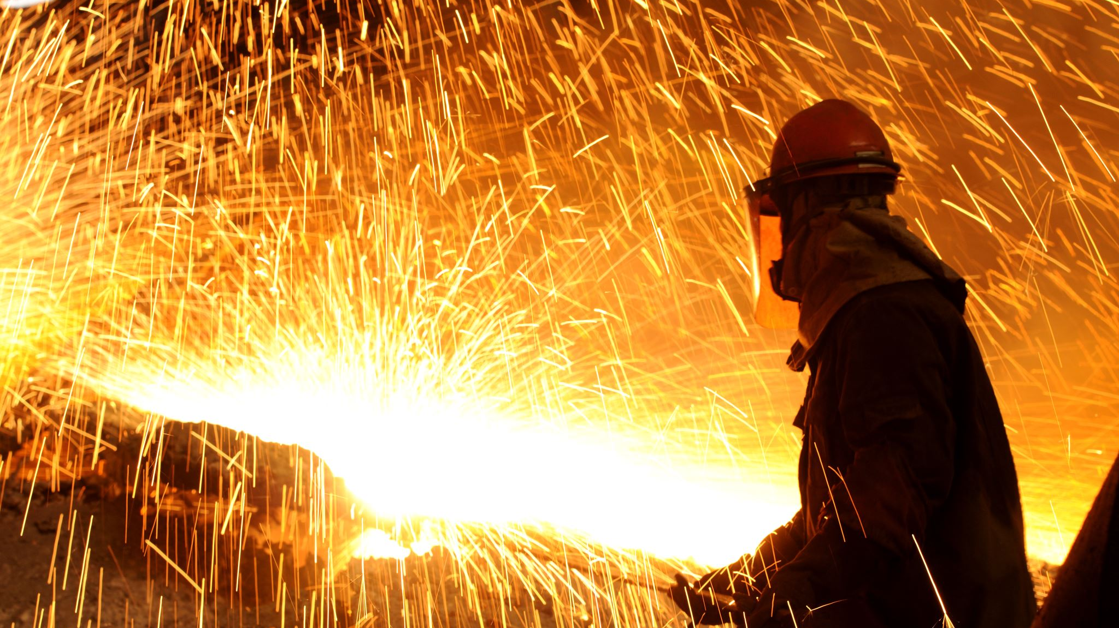
Hot Work Operations

Slide 2
Apply for a Permit
Go to the University of Oregon Fire Marshal Group webpage and click on the Request a Hot Work Permit button.
Fill out the Permit Request Form with all relevant information about Hot Work operations to be performed.

Slide 3
Identify fire Hazards and Prepare Site
Remove combustible materials within 35 feet of operation.
Sweep floors clear of combustible material.
Use fire resistant blankets, screens or shields to protect stationary combustibles.
Ensure there are no flammable gasses, vapors, or liquids in the area.
Check tools to make sure they are undamaged and in good working order.
Have a fire extinguisher onsite at all times during operation.

Slide 4
Emergency and False Alarm
In the event of a fire, all personnel involved in any hot work operations must have the following available:
Building name, address, and room number of hot work operation.
Fire extinguisher and personnel trained in extinguisher operation.
Ability to call 911 / Activate fire alarm.
In the event of a False Alarm of Fire System Activation
Call UO dispatch: 541-346-2919
Notify building manager.

Slide 5
Automatic Fire Sprinkler Systems
Smoke Detectors
Activated by smoke and dust particles in the air. False activation is not limited to hot work operations.
Heat Detectors / Heat Activated Sprinkler Heads
Activated by surpassing minimum heat detection threshold.
Approved Shielding Techniques
Capping of smoke detectors to prevent particles from entering the detector.
Erecting heat shield barriers.
Wrapping heat sensitive hardware in damp non-combustible material to prevent heat transfer.
Proper shielding techniques to prevent activation are required.
Proper ventilation techniques and shielding of detector when necessary is required.

Slide 6
Common Types of Fire Extinguishers
ABC Dry Chemical
General purpose for class (ABC) fires.
Most commonly used in business areas.
Carbon Dioxide (CO2)
Primarily used for electrical fires.
Used around sensitive electrical equipment.
Water
Used for paper, wood, and other solid combustables

Slide 7
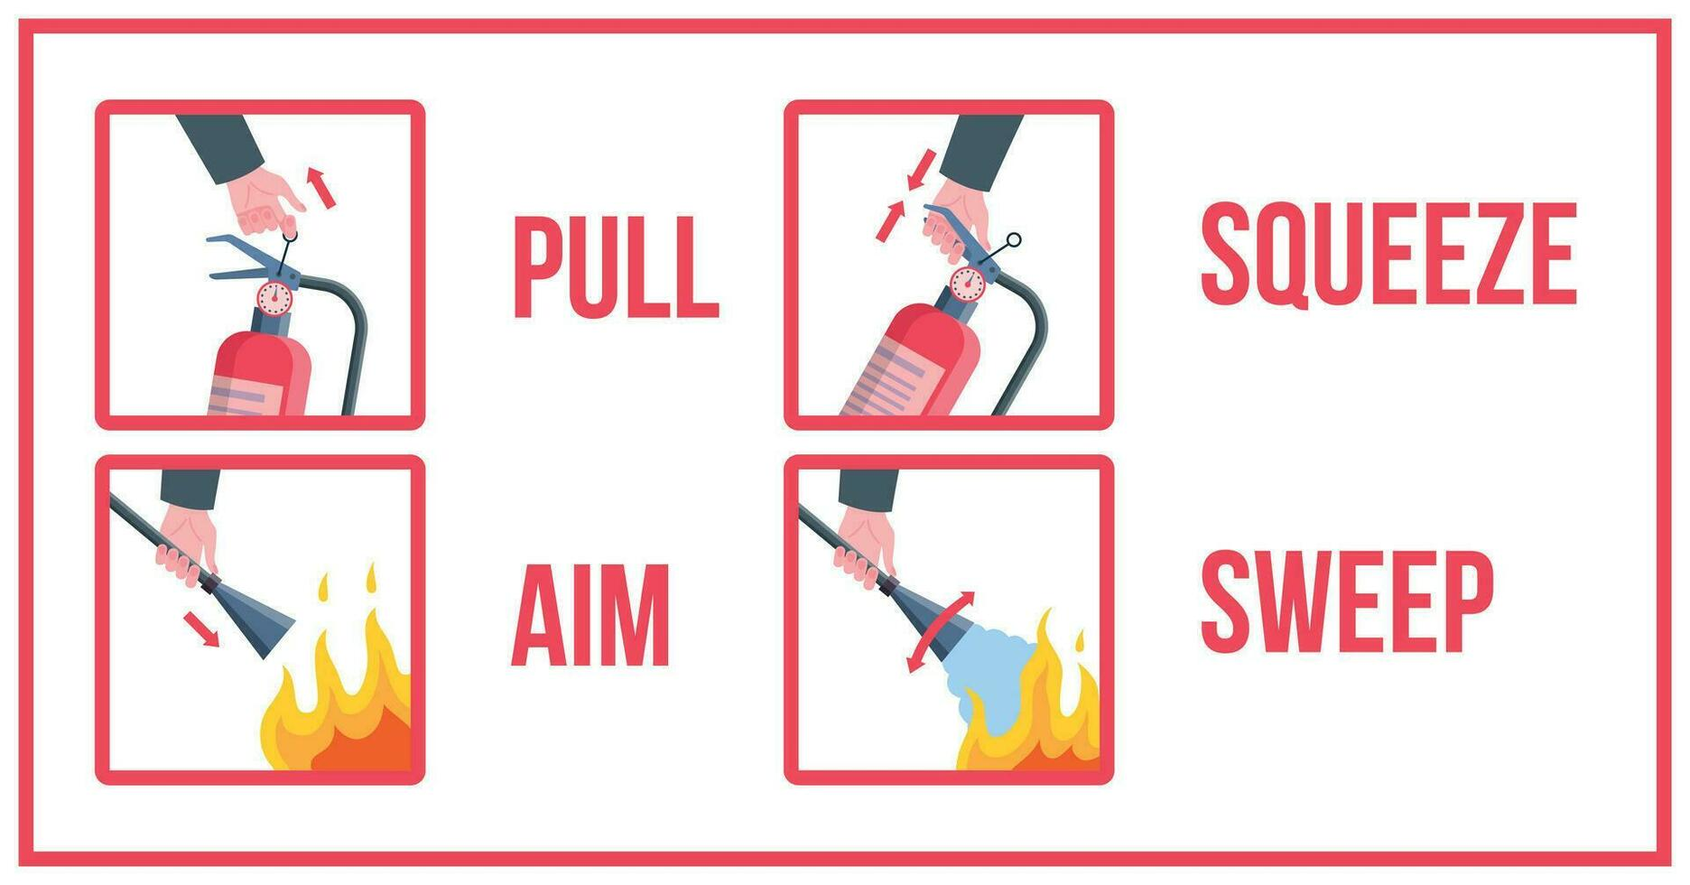
Fire Extinguisher Operation

Slide 8
Fire Watch
Dedicated personnel must be appointed to provide Fire Watch during hot work operations and for at least 30 minutes after completion.
Personnel providing Fire Watch must be trained in Extinguisher operations and fire emergency procedure.
Personnel providing Fire Watch must provide coverage in all areas with compromised fire detection equipment and suppression hardware.
If the compromised fire detection area is in more that one room, then the personnel on Fire Watch must patrol the affected area every 15 minutes until Fire Watch is complete.

Slide 9
Additional Information
Notify UO Dispatch before beginning work and once operations cease.
1
Provide contact information to dispatch and list contact information on permit in case of emergency.
2
Post Hot Work Permit in a visible and accessible location near work site.
3
If operations take place over multiple days, all hardware and equipment must be put back into working order.
4
Always use all appropriate and approved Personal Protective Equipment during Hot Work operations.
5

